Slide 1


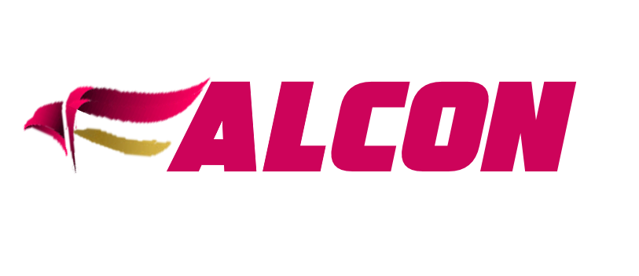
leverage your ROA
A Comprehensive Asset Management solution for asset lifecycle and maintenance management

Slide 2





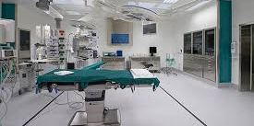
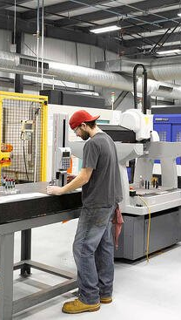
asset management system
PRODUCT DEMO
WORK FASTER
PREVENT WASTE
LOWER ASSET MGMT COSTS

Slide 3
leverage your ROA
Scalable framework enables businesses to gain better control over equipment's and maintenance activities.
Manage work to maximize asset performance, reduce downtime, improve efficiency, and control costs.
Align maintenance performance with overall business strategies and objectives.
Fulfill the regulatory compliances like ISO 55000, GMP, FDA etc.
Suitable for businesses of any size and any industries.
Available on premise or in Cloud with flexible pricing model

Slide 4

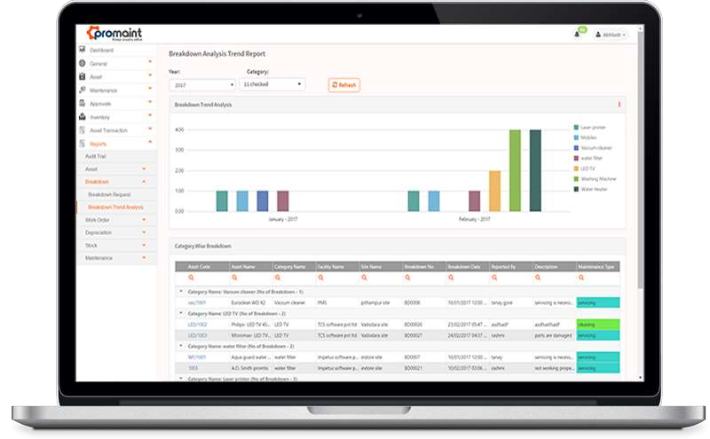
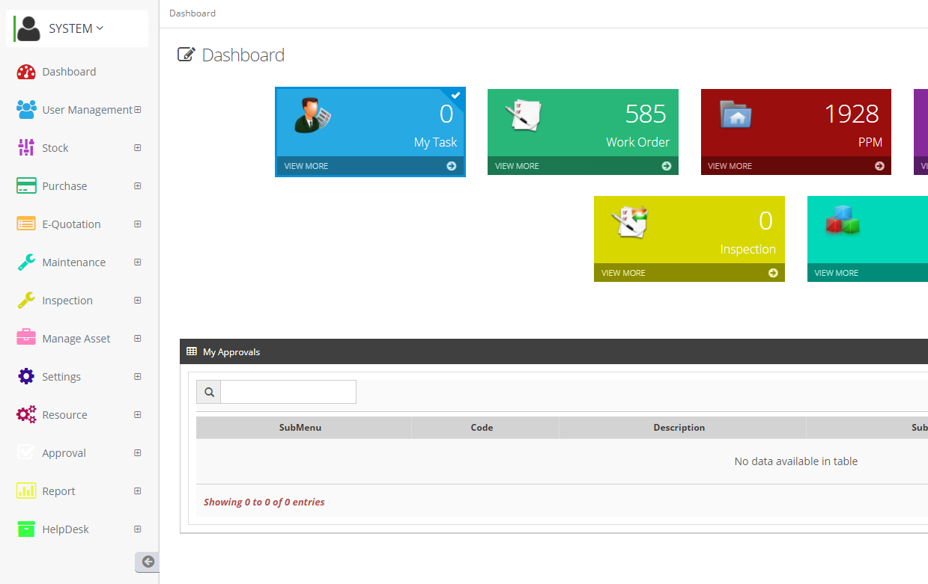

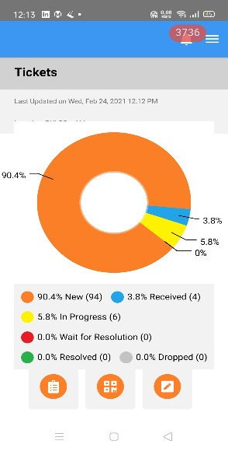
Elegant visual interface for easily accessing and interpreting various data.
leverage your ROA

Slide 5
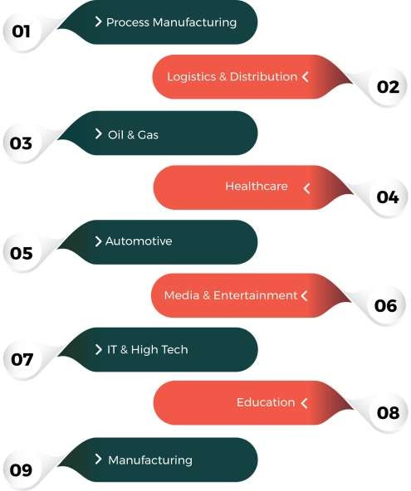
Suited for a wide range of industries
leverage your ROA

Slide 6
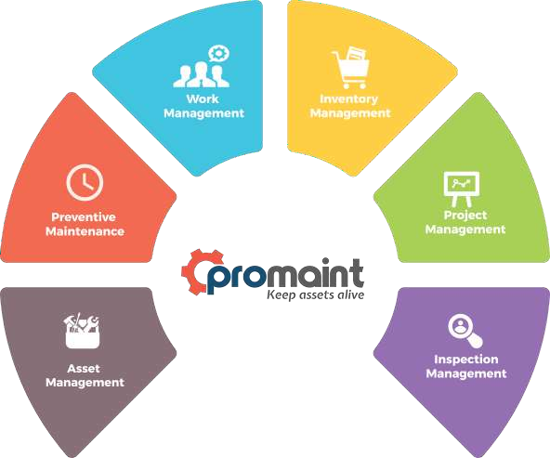
Procurement
Management
Modules which make your maintenance easy and cost effective.

Slide 7
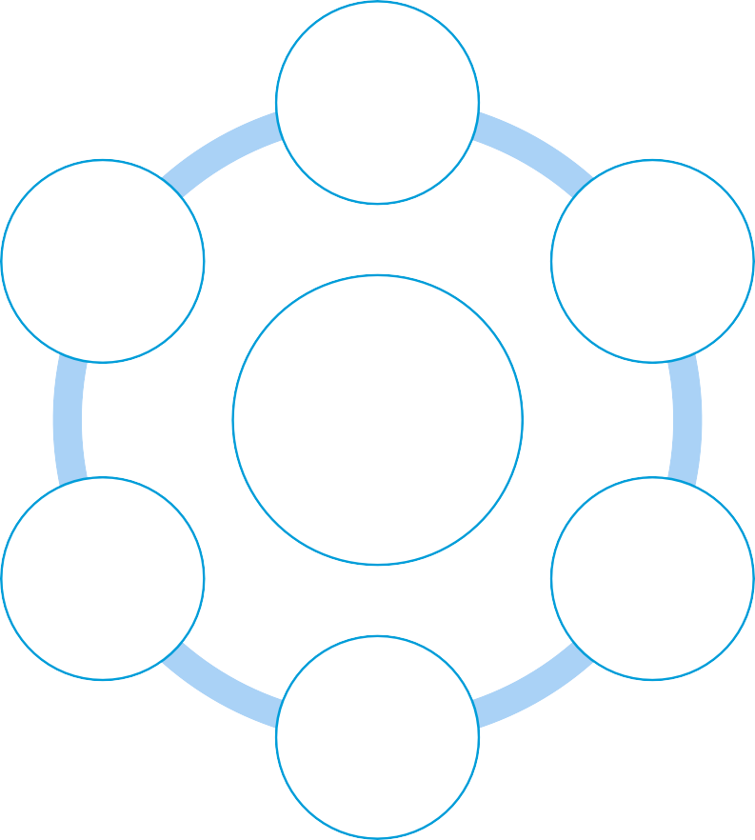
Asset Management
leverage your ROA
Equipment & Facilities
Manage entire life-cycle of each asset from its acquisition to retirement.
Store information like description, make, model, serial no., photos and more for each equipment.
Asset Moves and Transfers; Asset Check-in and
Check-out; Asset Operation audit trails;
Manage multi-site and multi facilities.
Manage warranties information
Manage related documents and safety procedures.
Depreciation calculation to maximizing monetary benefits from tax deductions.
Track asset history and generate robust reports
Asset Retirement
Equipment & Facility Approval
Asset Management
Asset Utilization Recording
Asset Tracking & History
Manage Asset Documents

Slide 8
Work Management
leverage your ROA
Receive, manage, and update work/service requests
Accept work requests from anywhere anytime which reduce emails, phone calls
Approval work flow according to defined
roles
Track all submitted work requests, and work orders status wise
Record and report parts usage, repair costs,
and work history
Eliminates paper work, reduce administration, and improve communication
Work Request
Close Work Order
Request Approval
Work Management
Work Review
Work Order
Work Order Processing

Slide 9
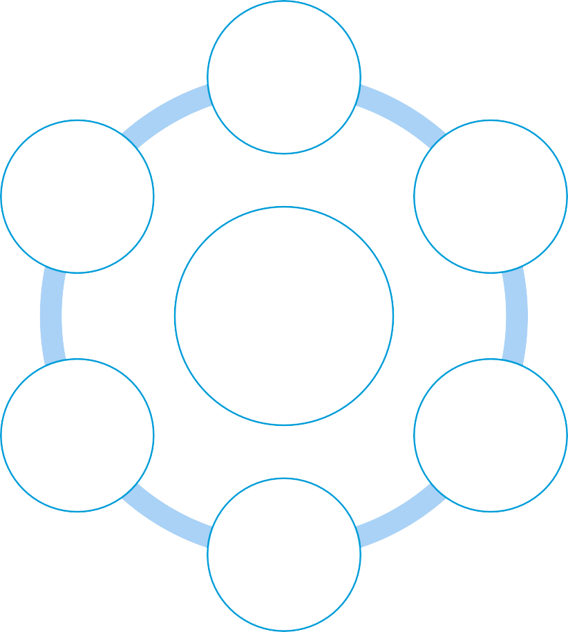
Preventive Maintenance
leverage your ROA
Preventive Maintenance Schedules
Manage yearly, monthly, weekly, and daily schedules
Base date/ base meter preventive maintenance Schedule.
Associate multiple PMs with a single asset or
vice versa.
Multiple task and parts association with PMs (bill of material and routing)
Minimize asset costs, increase reliability, and extend asset life.
Helps to prevent un-necessary equipment
failures.
Increase assets performance, reduce downtime,
improve efficiency, and decrease maintenance costs.
Create Work Order
Asset Association
Preventive
Maintenance
Due
Maintenance
PM’s
Approval
PM’s
Triggering

Slide 10
Inventory Management
leverage your ROA
Purchase
Requisition/
Order
Purchase requisition / order generation based on re-order points or indent
Requisition and Purchase Order approvals by authorities
Parts requisitions and issuance against a work
order
Maintain separate parts inventory at technician end
Maintain re-order, minimum, and maximum inventory points to maintain safety stock
Parts linking with assets and PM’s which typically used to repair an asset
Control inventory across various sites effortlessly
Extra Parts Return
Purchase Order Approvals
Inventory Management
Part Issuance
Material Receipts
Parts Requisition

Slide 11
Inspection Management
leverage your ROA
Complete cycle of Inspection from Check Lists, Inspection schedules, result recording, and corrective actions to completion
Check Lists
Rectify Issues & Completion
Inspection Plan & Scheduling
Easily identify and assign follow-up task related to inspection findings. Ensure their completion with escalating emails notification and dash boards that display completed, pending, and overdue task.
Inspection Management
Enables the plant to be returned to service in a safe operating condition
Corrective Actions
Inspection Order & Result
Gain complete visibility into inspection program and
manage inspection data in a secure centralized system
Identify Issues
Reduce liability and fulfil compliance requirements.

Slide 12
Security
leverage your ROA
Store Password in Encrypted form
Role based permission
Regular Password Expiration
Lock System Login after defined limit of Login failures
Maintain user log and Password Strength
Different Password for Approval from Login Password.

Slide 13
Compliances
leverage your ROA
Required Electronic Signature on various approvals.
Complete audit trail of each master and transaction
Required Approval for essential transactions

Slide 14
Other Features & Benefits
leverage your ROA
Simple user friendly, powerful application
Easily integrate with your existing ERP System
Alerts & Notification on various stages of maintenance
Full mobility in maintenance and inspection modules
Optimize operations, eliminates need of spreads sheets
Fully integrated, email-savvy help desk that supports multiple teams and mobile users

Slide 15

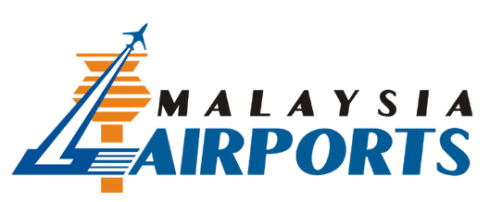


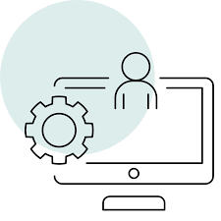
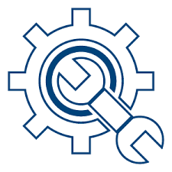

@
Success Story
International Airports Implemented
Cost Centers
x 10
Sub Cost Centers
x 100
Maintainable Assets
x 1000
Stocks & Spares in 12 warehouses
x 1000
Non Maintainable Assets
x 10000
Web based application
Smart Tab on Android
Central Asset Registration
Feedback & Survey
> 120 concurrent users

Slide 16
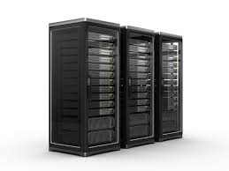

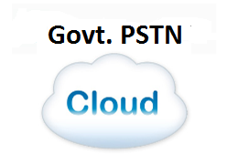
Offered as On Premise or Cloud

Slide 17
Thank You
leverage your ROA

